Slide 1
Flo-Motion Games: IT Security Assesment
Charles Kanakan

Slide 2
Introduction
Vulnerability Assessment
Security Policy
Business continuity plan

Slide 3
Vulnerability Assessment
Assets
Threat identification
Vulnerability
Risk mitigation

Slide 4
Asset List and Valuation
Physical assets
Human assets
Information Technology assets
Hardware
Software
Data

Slide 5
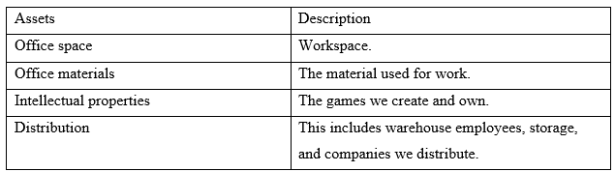
Physical Assets

Slide 6
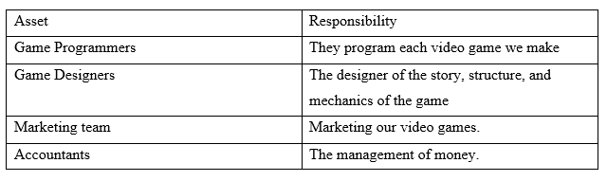
Human Assets

Slide 7
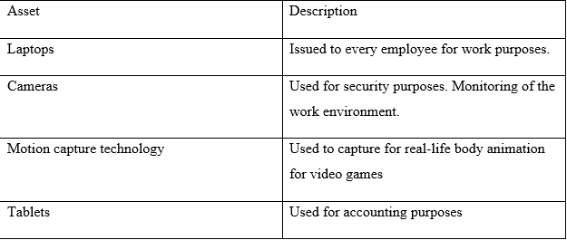
Information Tech Assets(1 of 3)

Slide 8
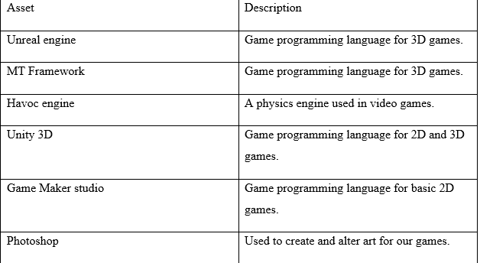
Information Tech Assets(2 of 3)

Slide 9
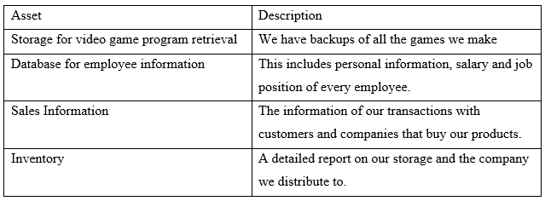
Information Tech Assets(3 of 3)

Slide 10
Threat Evaluation
Threats to hardware
Threats to software
Physical threats

Slide 11
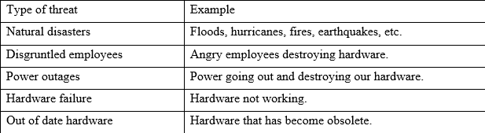
Threats to Hardware

Slide 12
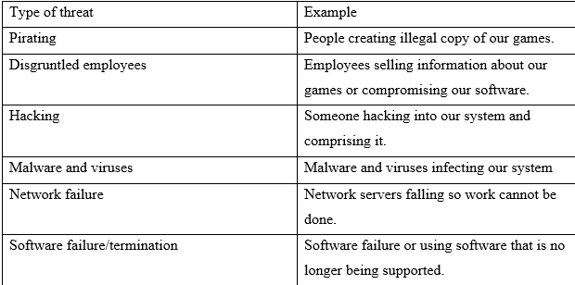
Threats to Software

Slide 13
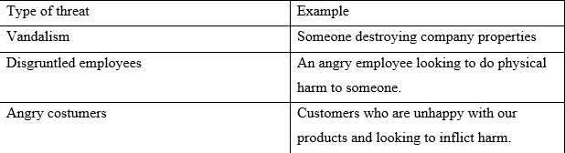
Physical threats

Slide 14
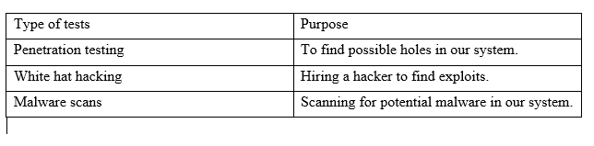
Vulnerability (1 of 3)

Slide 15
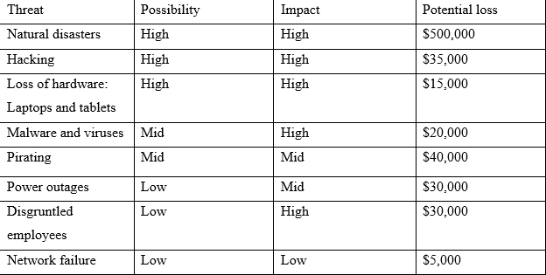
Vulnerability (2 of 3)

Slide 16
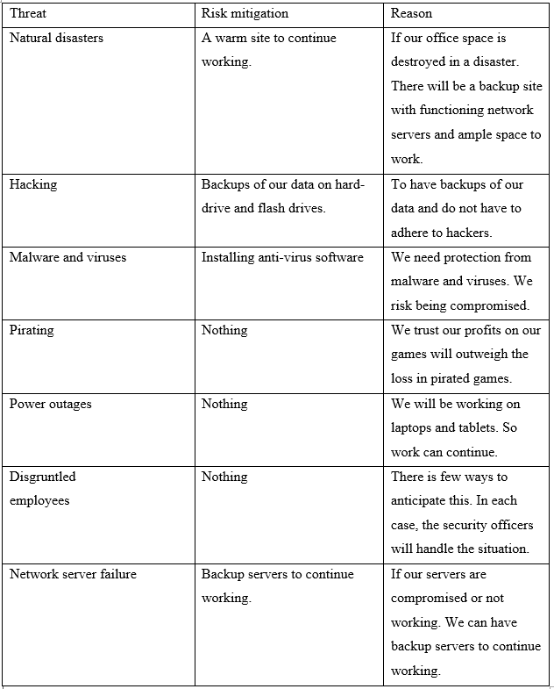
Vulnerability (3 of 3)

Slide 17
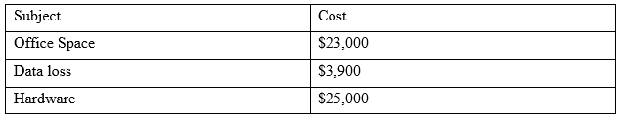
Acceptable loss

Slide 18
Security Policy
Policy summary
Policy on equipment
Employee access policy
Physical security policy
Violation

Slide 19
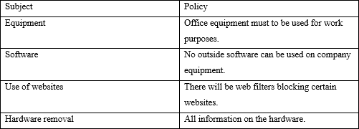
Policy on equipment

Slide 20
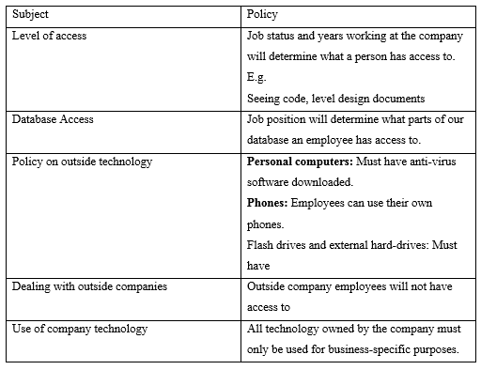
Employee Access Policy

Slide 21
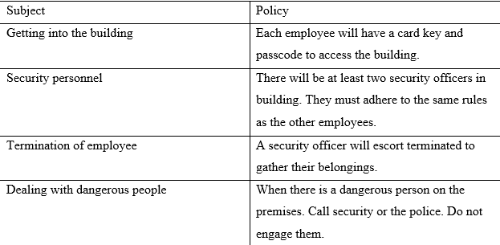
Physical Security Policy

Slide 22
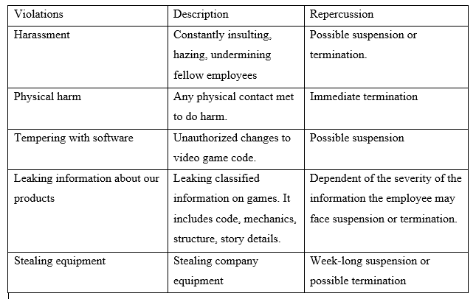
Enforcement

Slide 23
Business Continuity Plan (BCP) (1of 2)
Summary of BCP
Teams
Responsibilities

Slide 24
Business Continuity Plan (BCP) (2 of 2)
Plans
Training
Creating a plan

Slide 25
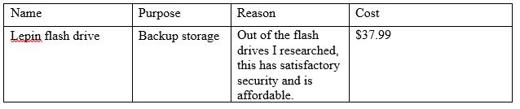
Production Acquisition (1 of 2)

Slide 26
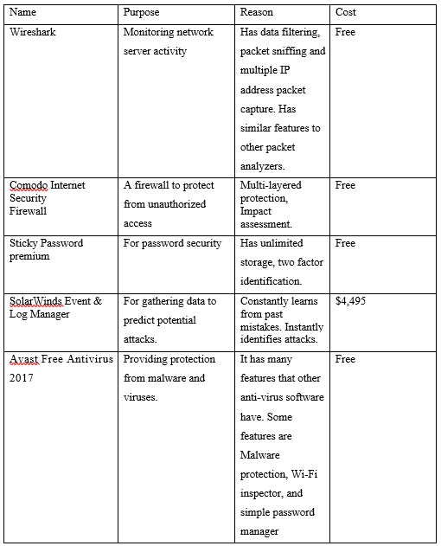
Production Acquisition (2 of 2)

